Slide 1
CS112 : Introduction to Python Programming
Week 1: lab practice

Slide 2
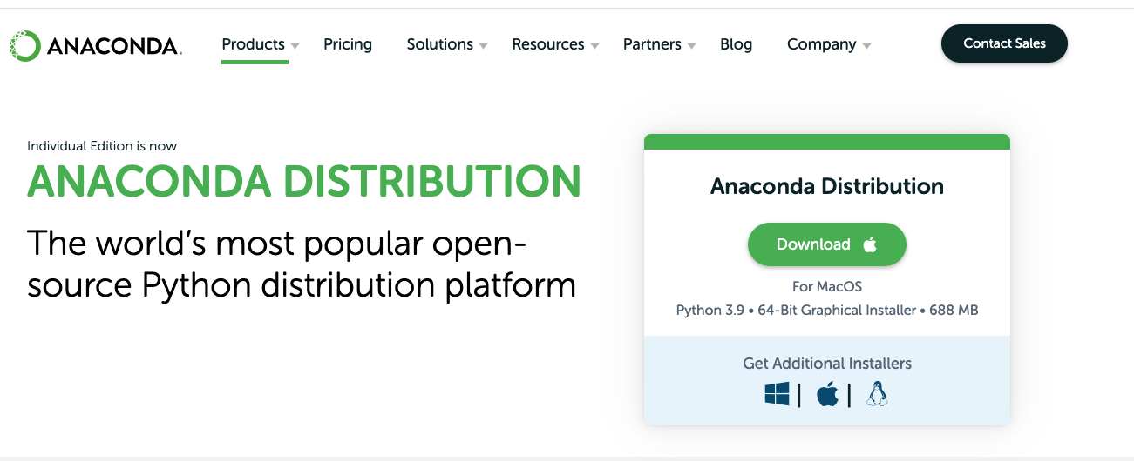
Practice 1
Download Anaconda and install it on your computer/laptop
https://www.anaconda.com/products/distribution
Instruction:
https://docs.anaconda.com/anaconda/install/

Slide 3
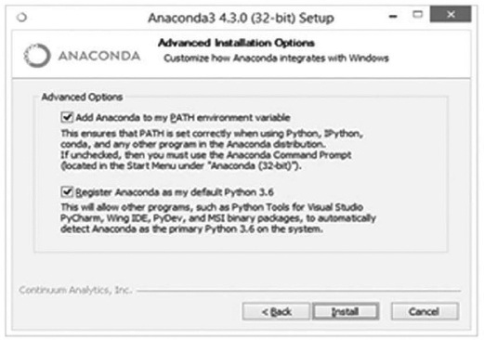
Practice 1
For Windows: check the Add Anaconda to my PATH environment variable. This will let you use Anaconda in your command prompt.

Slide 4
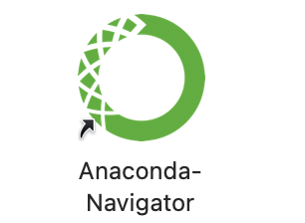
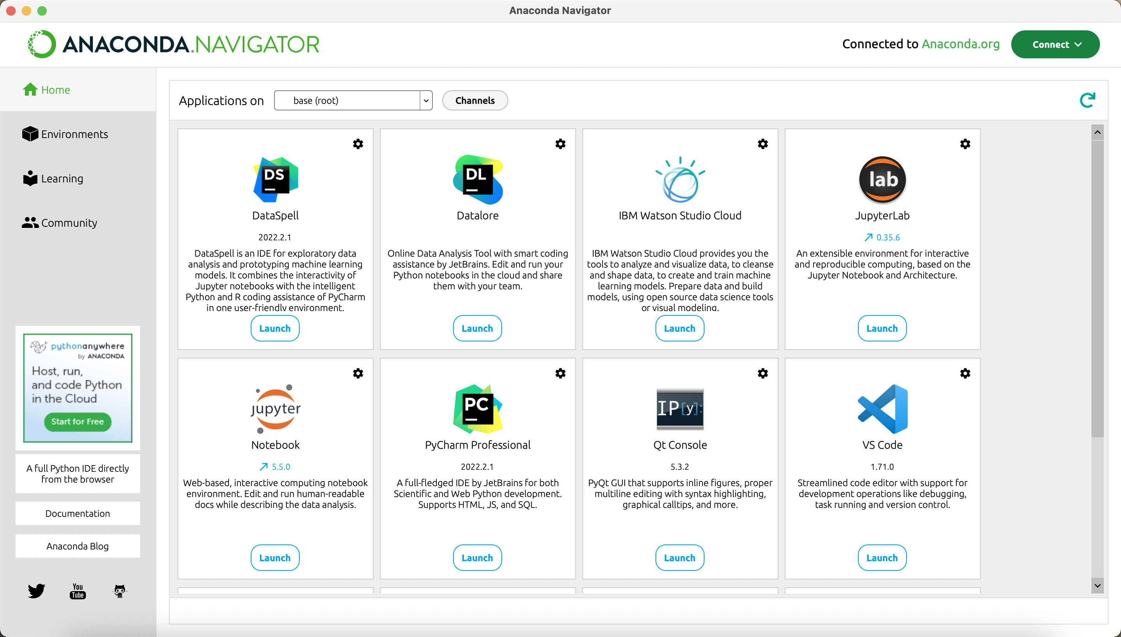
Practice 1
Anaconda-Navigator:
A desktop graphical user interface (GUI) to launch applications and manage conda packages, environments, and channels without using command line interface (CLI) commands.
Documentation:
https://docs.anaconda.com/navigator/

Slide 5
Practice 2
Run python in the command line
Windows:
Open cmd.exe (Win+R -> cmd)
or Anaconda-Navigator -> Anaconda Prompt
Type ‘Python’ and Enter
To quit, type ‘quit()’
macOS & Linux:
Open Terminal
Type ‘Python’ and Enter
To quit, type ‘quit()’

Slide 6
Practice 3
Print “Hello World” in Python using 4 programming modes
Command-line mode
Scripting mode
IDE mode
Anaconda-Navigator -> Pycharm https://www.jetbrains.com/pycharm/
OR
Visual Studio Code
Jupyter Notebook
Command line : jupyter notebook
Or Anaconda-Navigator -> jupyter notebook

Slide 7
Practice 4
Read the following material and get familiar with Jupyter Notebook.https://realpython.com/jupyter-notebook-introduction/
Q1: What is the function of each button?
Q2: What are Code and Markdown cell types?
Q3: What formats can a notebook be saved as?
Save a notebook in .py format and execute it using python
Q4: How to save and open a notebook?

Slide 8
Practice 5
Install the python packages pandas and numpy using conda
In the command line or Anaconda Prompt, type “conda install XXX”

Slide 9
Practice 6
1. Create a new environment named cs112 with packages pandas and numpy
conda create --name [your_env_name] [package]
2. Activate and deactivate the cs112 environment

Slide 10
Practice 7
Read the following material and get familiar with Jupyter Notebook.https://realpython.com/jupyter-notebook-introduction/
Q1: What is the function of each button?
Q2: What are Code and Markdown cell types?
Q3: What formats can a notebook be saved as?
Save a notebook in .py format and execute it using python
Q4: How to save and open a notebook?

Slide 11
Markdown
Markdown is a plain text formatting syntax aimed at making writing for the internet easier.
Syntax
https://markdown.com.cn/intro.html
https://markdown.com.cn/basic-syntax/
https://www.markdownguide.org/basic-syntax

